Slide 1
Group Meeting
Ziyi Xi
05/28/2019

Slide 2
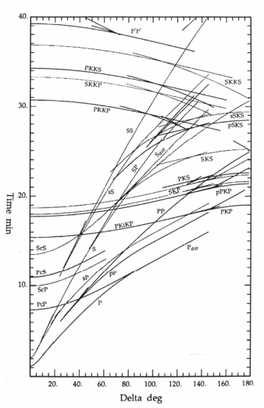
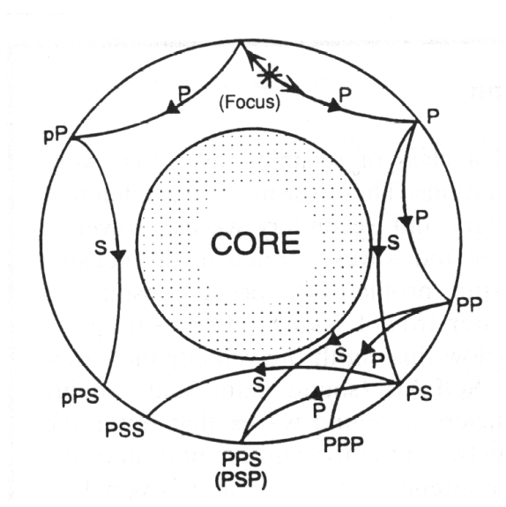
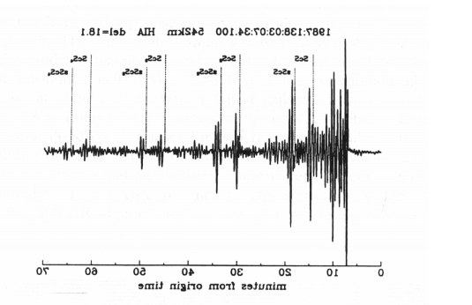
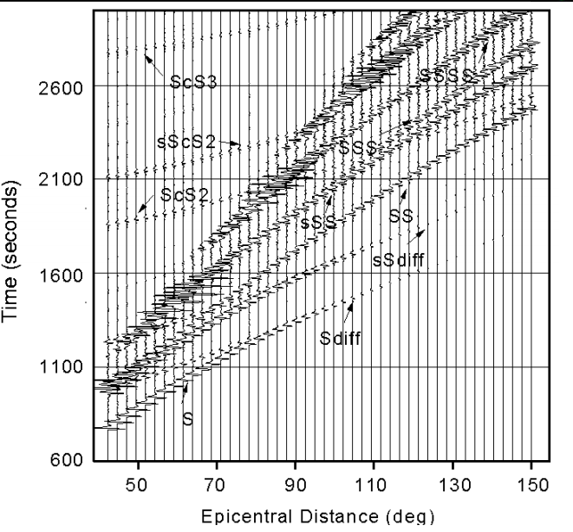
Motivation: Why we want to pick phases automatically?
https://www.geophysik.uni-muenchen.de/~igel/Lectures/Sedi/sedi_inter.pdf
By Prof. Heiner Igel

Slide 3
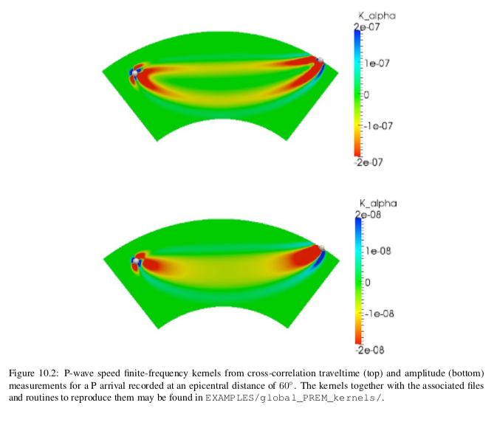
Why we pick phases in FWI?
From the documentation of Specfem globe

Slide 4
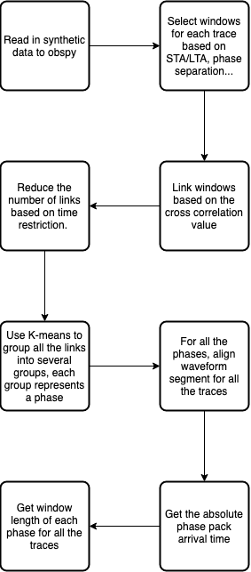
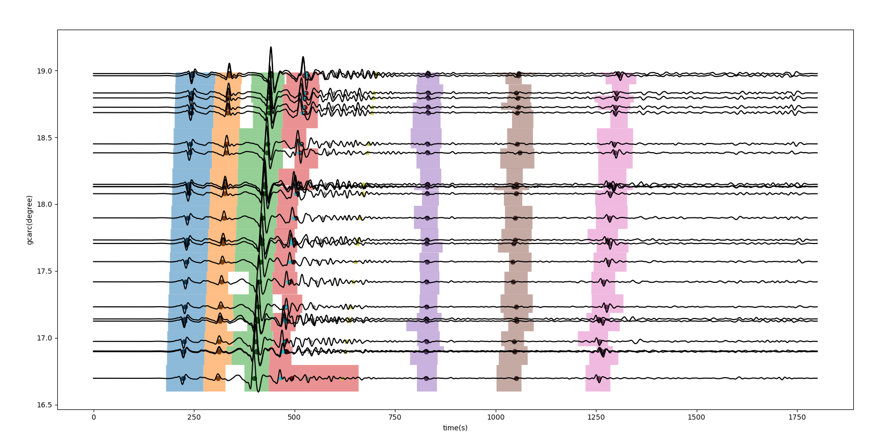
How the WindowLink package works?

Slide 5
The algorithm to link windows with the same phase in different traces
Use STA/LTA to get windows for each trace. (may contain phases)

Slide 6
An example of windows’ link
Repeat it, then we can get all the possible links.
Notes:
An example of

Slide 7
Combine links together
Matrix W
Each row: one windows’ link
Each column: one trace
Value: window’ id in its trace
Take the above one as an example
0 | 0
1 | 1
2 | 2
3 | 3
4 | 4
5 | 5
5 | 6
6 | 6

Slide 8
Use K-means to group phases together
“Nearby” window link may represent the same phase. (link the physical meaning of perturbation)

Slide 9
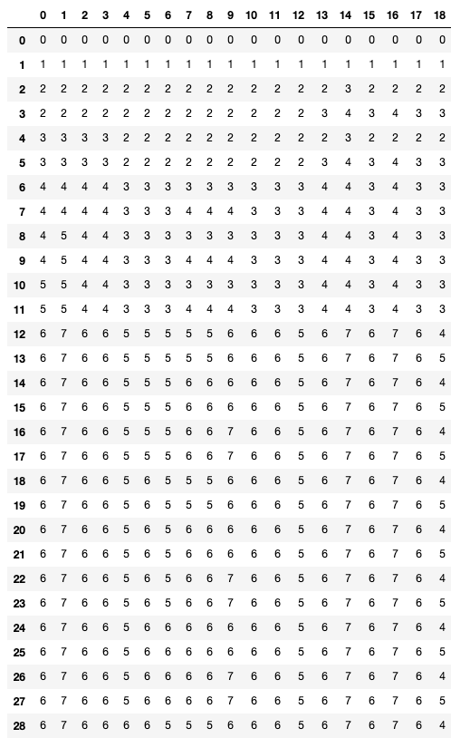
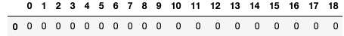
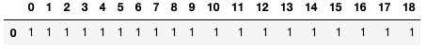
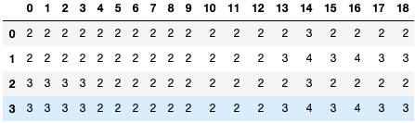
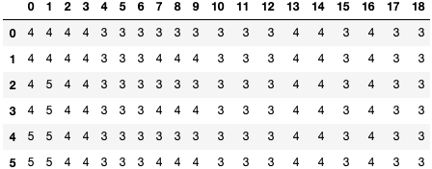
A real example
For each group of links, we will see for which trace the waveform segment could represent this phase.
Correct peak arrival time for these “representative” traces in each group.
Get the absolute peak arrival time.

Slide 10
Result
Idea
Divide windows for each trace.
Find the most similar windows for nearby traces which represents the same phase, and link them together.
Repeat it, link all the traces together.
Problems
It’s common windows are not linked correctly for nearby traces. (use cc is not enough)
If one trace has problem, the linking process will be terminated.
Difficult to handle all the cases. (In fact it’s impossible to handle all the cases, I’d like not to link the phases that may have a problem)
How to solve the problem?
Add time constriction.
Consider several nearby traces but not the nearest one.

Slide 11
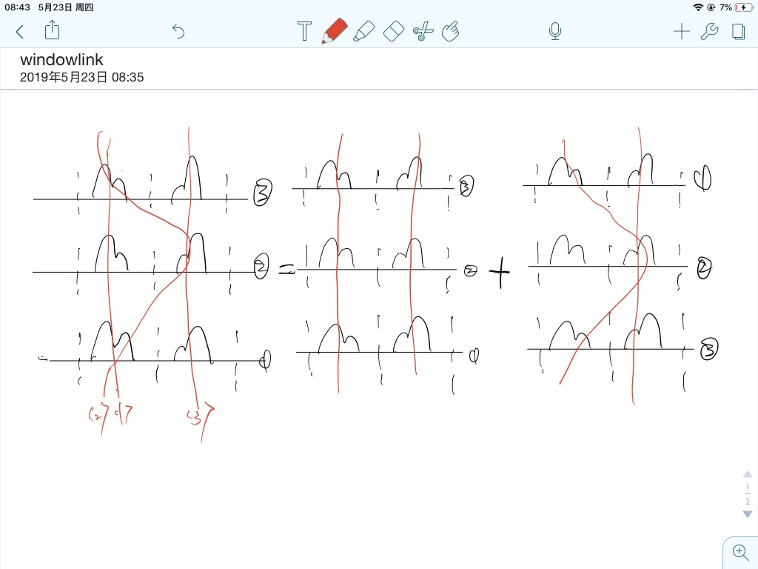
Link nearby windows
Firstly link windows from one direction.
Then link windows from the other direction.

Slide 12
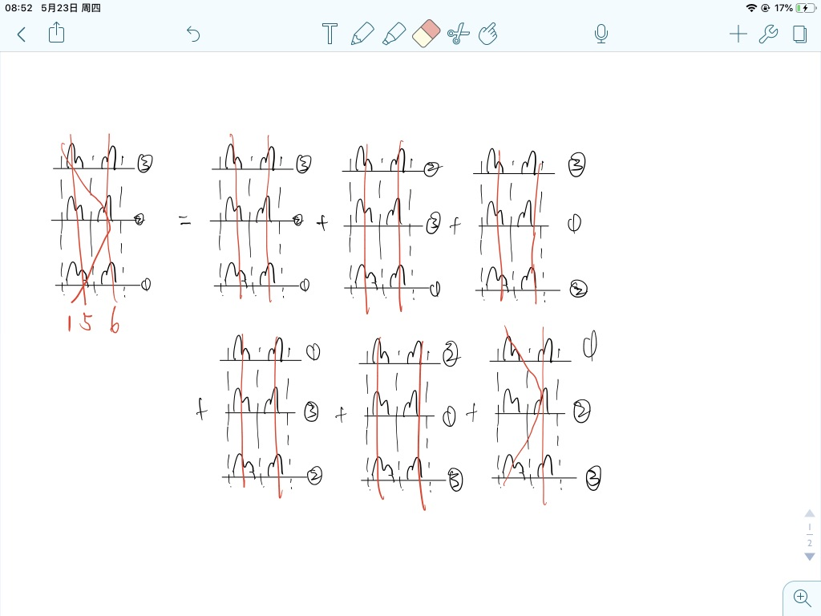
Consider several nearby traces
Find all the possible links considering all the linking order.
Use the number of repeating links as the weight in K-means.
K-means:
Finally we will have all the possible links, including the correct links and incorrect links. If two links are similar, they are belonging to one phase. (perturbation)

Slide 13
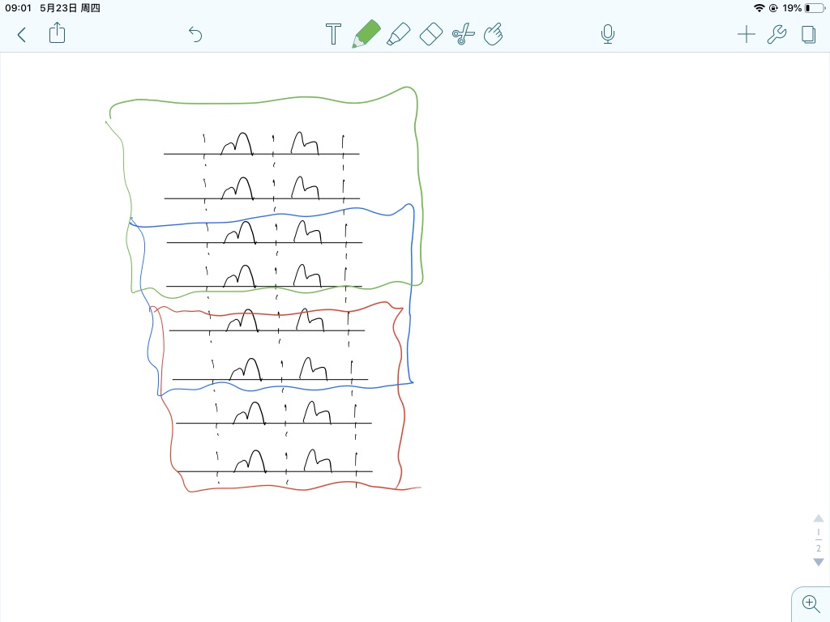
Divide all the traces into several small groups
Divide traces into several small groups. (could depend on the epicenter distance for example, not require the number in each group to be the same)
Extend the linking result based on the “common area”

Slide 14
Events

Slide 15
Stations

Slide 16
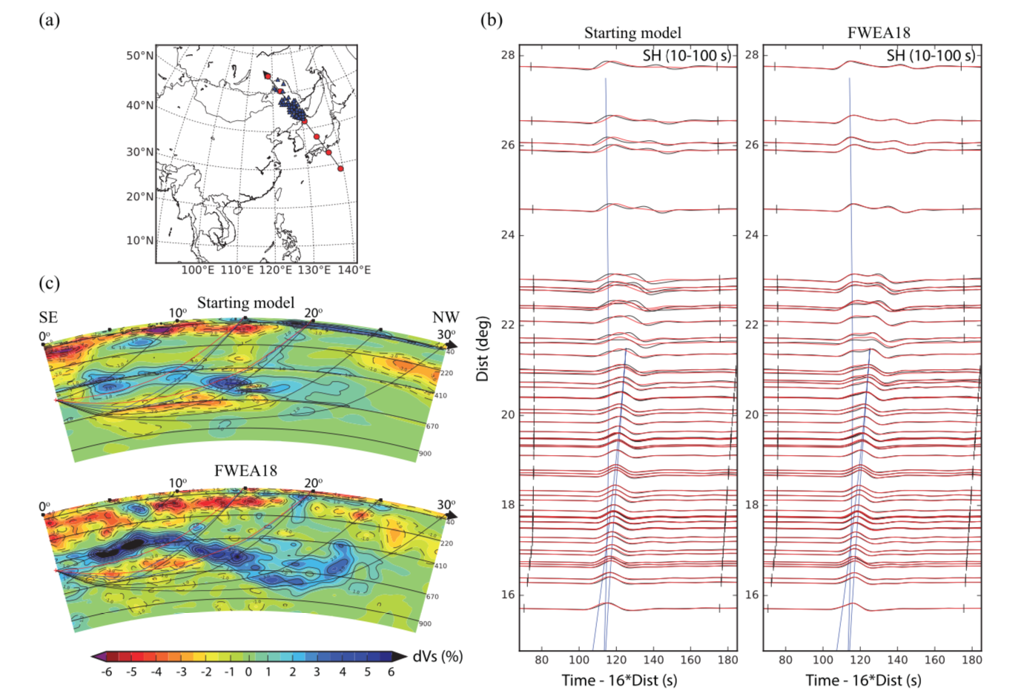
From Tao Kai’s paper

